Slide 1

Tiny Pulse +
Blood Pressure Monitoring using Edge Artificial Intelligence
Anbu Valluvan Devadasan
Advisor: Prof. Mohammad Masum

Slide 2
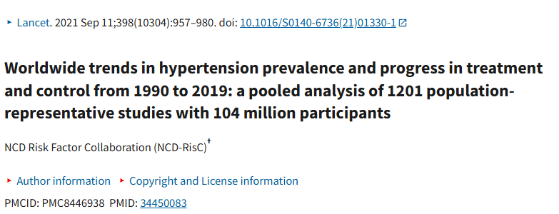


The Challenge
Global Impact of Hypertension
Hypertension affects 1 in 3 adults worldwide with 1.3 billion people living with the condition as of 2019.
It is the single most important risk factor for early deaths globally leading to an estimated 10.8 million avoidable deaths annually.
The global burden is disproportionately high in low and middle
income countries where 82% of people with hypertension reside.
Economic impact is substantial affection patients, health system
and national economies
Department of Applied Data Science

Slide 3

Need for Continuous, Non-Invasive Monitoring of Blood Pressure
Limitations of Current Methods
Oscillometric Cuff based Measurements
Limited temporal resolution
Impractical for continuous monitoring
Measurement artifacts due to patient discomfort
White coat hypertension affecting diagnostic accuracy
Emerging Technologies
Cuffless Blood Pressure Estimation
Utilizes photoplethysmography (PPG) and electrocardiography (ECG) signals
Enable continuous, non-invasive monitoring
Edge Artificial Intelligence
Facilitates on device inference
Addresses data privacy concerns
Department of Applied Data Science

Slide 4
Challenges in wearable BP monitoring
Accuracy and Cross Subject generalizability issues
Subject Specific calibration: Barrie to large scale deployment
Optimization of deep learning architectures for resource constrained environments
Study Objectives
Develop accurate models for estimating Mean, Systolic and Diastolic Blood Pressure
Optimize model for deployment on resource constrained devices
Evaluate Performance & efficiency of models.
Contributions
Edge Artificial Intelligence based framework for Blood Pressure estimation
Demonstration of continuous Blood Pressure monitoring on wearables without subject specific calibration
Insights into performance vs efficiency trade-offs in Edge AI healthcare applicatiopns
Department of Applied Data Science

Slide 5
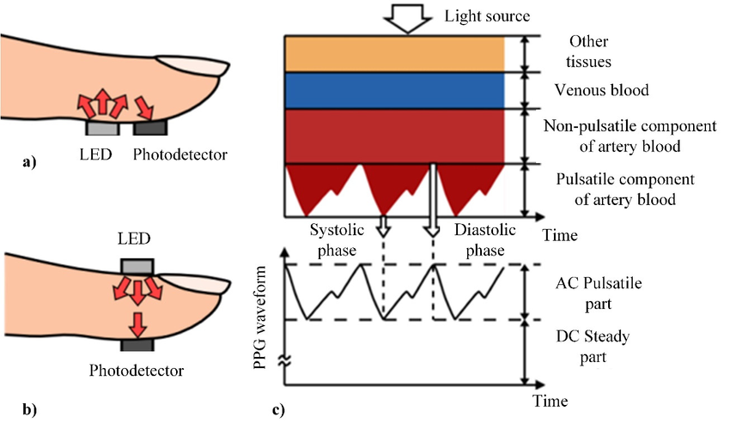
Photoplethysmography (PPG)
PPG is a non-invasive optical technique that measures blood volume changes in microvascular tissue.
Principles – The fundamental operation relies on light interaction with tissue through absorption, scattering and transmission properties. The technology uses specific wavelengths of light.
Red (640-660nm) – reaches arteries in subcutaneous tissues
Infrared (880-940nm) – provides deep tissue penetration
Green (470nm) – penetrates less than 1mm into tissue
Signal Components
AC Component (Pulsatile)
Reflects cardiac-synchronous changes in blood volume
Synchronized with cardiac cycle
Related to – vasodilation, vasomotor activity, vascular tone
DC Component (Non-pulsatile)
Influenced by – tissue composition, basic blood volume,
respiration, sympathetic nervous system, thermoregulation
Waveform Characteristics
Key features
Pulse onset: Starting point of pulsation
Systolic peak: Maximum blood volume point
Dicrotic notch: Recessed point during diastole
Diastolic peak: Point where first derivative approaches zero
Human Emotion Recognition: Review of Sensors and Methods - Scientific Figure on ResearchGate. Available from: https://www.researchgate.net/figure/Principle-of-photoplethysmography-PPG-104-a-reflective-mode-b-transmitting_fig7_338723696
Department of Applied Data Science

Slide 6
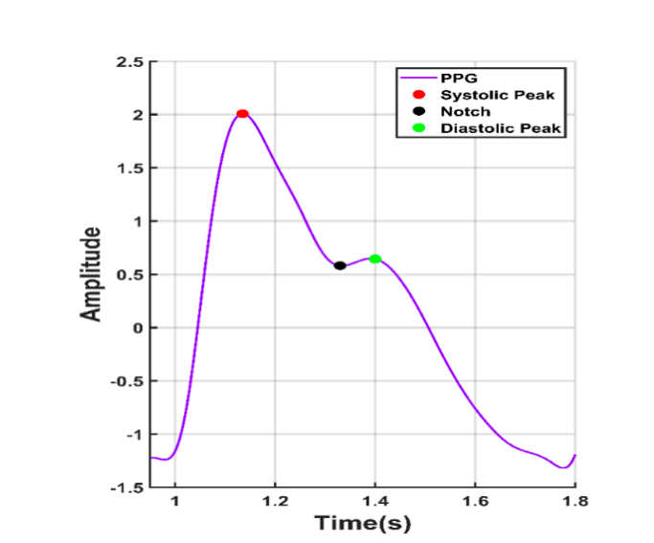
Photoplethysmography (PPG)
Blood Pressure Estimation Methods
Synchronicity dependent Approach
Requires additional bio signal measurement (typically ECG)
Uses Pulse Transit Time (PTT)
Asynchronicity-dependent Approach
Uses PPG signal alone
Analyzes waveform morphology
Employs advanced deep learning techniques
Technical Implementation
Sensor Types
Transmissive: Photodetector opposite to LED
Reflective: Photodetector adjacent to LED
Signal Processing Pipeline
Adaptive filtering
Statistical normalization
Temporal peak-to-peak alignment
Quality assessment for noise reduction
Department of Applied Data Science

Slide 7
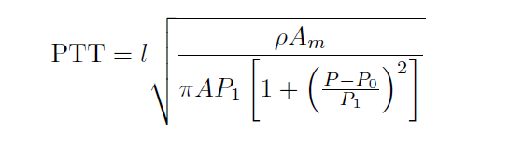
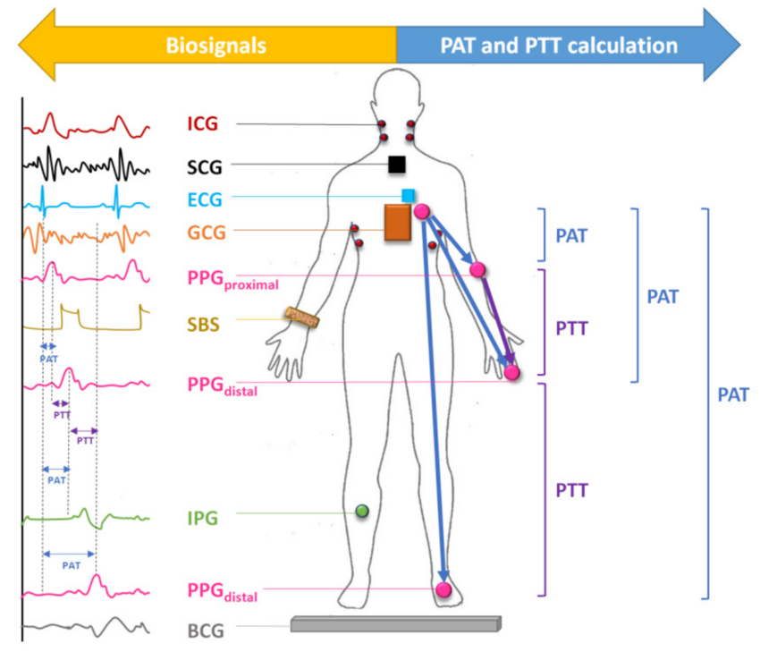
Photoplethysmography (PPG)
Pulse Arrival Time : Pulse Arrival Time is the time elapsed between the electrical pulse initiating the heartbeat, instead of the heart beat itself as in pulse transit time and the arrival of the heartbeat to a body peripheral.
Pulse Transit Time : Pulse Transit Time is the time elapsed between a heartbeat and the arrival of the beat to body peripheral.
ρ is blood density, P0, P1, A, and Am are all person-dependent values,
and l is the length of the artery considered
Multimodal Photoplethysmography-Based Approaches for Improved Detection of Hypertension - Scientific Figure on ResearchGate. Available from: https://www.researchgate.net/figure/Determination-of-pulse-arrival-time-and-pulse-transit-time-in-various-modalities-that_fig1_340867964
Department of Applied Data Science

Slide 8
Photoplethysmography (PPG)
Clinical Applications
Continuous blood pressure monitoring
Heart rate measurement
Vascular assessment
Autonomic function evaluation
Limitations and Considerations
Signal quality affected by motion artifacts
Individual variations due to – race, skin color, fingernail color, finger size
Environmental factors impact measurement accuracy
Department of Applied Data Science

Slide 9
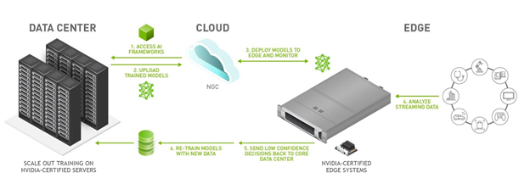
Edge Artificial Intelligence
Edge Artificial Intelligence represents a paradigm shift in artificial intelligence deployment, where computational processes occur at or neat the data source rather than in centralized cloud facilities. This technology combines AI capabilities with edge computing infrastructure, enabling direct processing on endpoint devices.
Fundamental Architecture
Data acquisition and processing at network endpoints
Local execution of machine learning algorithms
Distributed computing across edge devices
Real time inference capabilities
Minimal cloud dependency
IoT sensors and devices
Edge computing infrastructure
Department of Applied Data Science
What Is Edge AI and How Does It Work? | NVIDIA Blog – Image Source

Slide 10
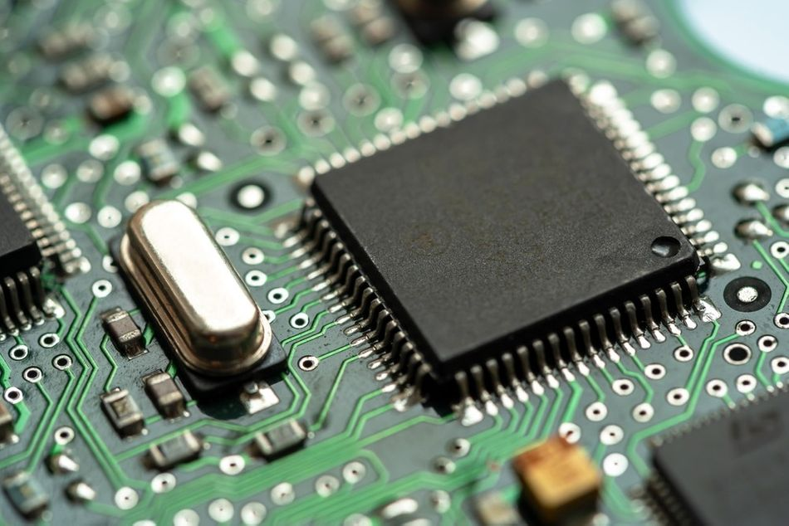
Edge Artificial Intelligence
Technical Components
Processing Infrastructure
Local processing units
Embedded AI algorithms
IoT sensors and devices
Edge-optimized neural networks
Microcontrollers
Dataflow Mechanics
Local data preprocessing
Feature extraction at source
Real-time inference
Processing Methods
Local AI model execution
Distributed computing architecture
Adaptive resource allocation
Real time data analytics
System Components
Edge devices and sensors
Local processing units
AI Algorithms
Secure data transmission protocols
Department of Applied Data Science

Slide 11
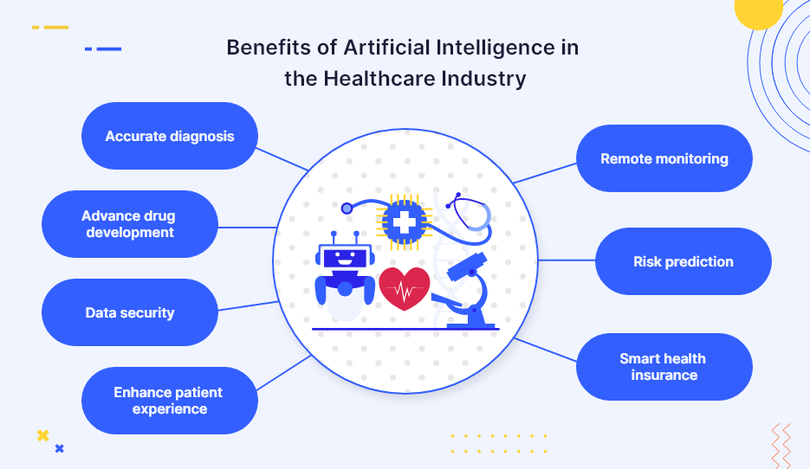
Edge Artificial Intelligence
Health Care Applications
Clinical Implementation
Remote patient monitoring systems
Point of care diagnostics
Emergency response systems
Medical Imaging analysis
Telemedicine platforms
Key Advantages of Edge AI in Health care
Performance Benefits:
Real time data processing and reduced latency.
Enhanced computational efficiency
Security and Privacy:
Local data processing
Minimized data transmission
Enhanced patient data protection
HIPAA compliance support
Department of Applied Data Science
AI In Healthcare: AI Transformation The Healthcare Industry – Image Source

Slide 12
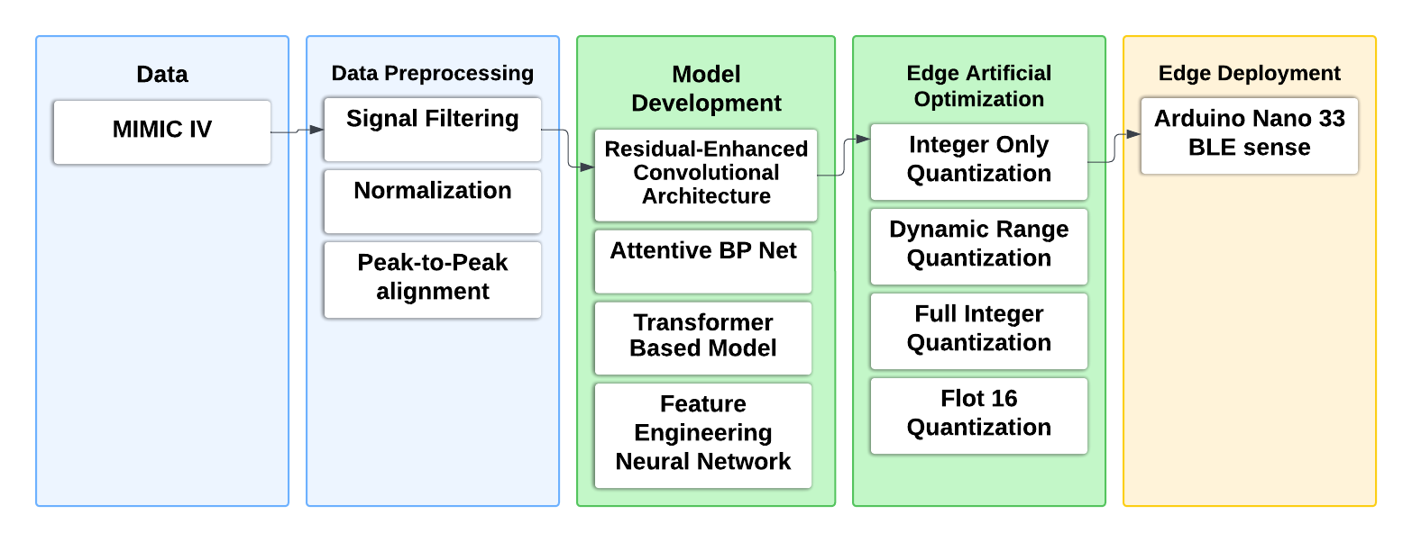
Framework
This investigation presents a comprehensive methodological framework for non-invasive blood pressure estimation using photoplethysmography (PPG) signals and Edge Artificial Intelligence.
The approach integrates advanced signal processing techniques with sophisticated deep learning architectures optimized for deployment on resource-constrained devices.
Department of Applied Data Science

Slide 13
Data Source
MIMIC IV Waveform Database
The empirical foundation of this study is established upon the MIMIC-IV Waveform Database (version 0.1.0), a comprehensive repository of high-fidelity physiological signals acquired from intensive care environments.
Justification for Database Selection
Encompasses multi-parameter physiological recordings including PPG, ECG, and continuous arterial blood pressure measurements
Data from 198 unique subjects, yielding 200 distinct records
Implements a sophisticated hierarchical organization paradigm
Facilitates efficient data retrieval and analysis through the WFDB software framework
Provides a robust foundation for developing and validating blood pressure estimation algorithms
Department of Applied Data Science

Slide 14
Signal Processing Pipeline
Adaptive Filtering
Implementation of fourth-order Butterworth bandpass filtering (0.5-8.0 Hz) for PPG signals
Fourth-order Butterworth high-pass filter (0.05 Hz cutoff) for ABP signals
Designed to preserve fundamental cardiac frequencies while attenuating noise components
Statistical Normalization
Robust min-max normalization protocol applied independently to each temporal window
Ensures consistent amplitude scaling across the dataset while preserving local signal characteristics
Temporal Peak-to-Peak Alignment
Sophisticated peak detection algorithm incorporating physiological constraints and adaptive temporal thresholding
Precise central peak localization through computational geometry
High-precision waveform translation employing circular convolution principles for optimal alignment
Department of Applied Data Science

Slide 15
Deep Learning Architectures
Residual-enhanced Convolutional Neural Network
Implements skip connections to mitigate gradient degradation
Hierarchical feature extraction paradigm with increasing filter depths (64→128→256)
Global average pooling for fixed-size representations
Transformer-based Architecture
Leverages self-attention mechanisms to capture long-range dependencies in PPG signals
Incorporates positional encoding to maintain temporal awareness
Stacked transformer layers with multi-head self-attention (8 heads)
Attentive BPNet
Integrates convolutional layers with an attention mechanism
Optimized to capture both local and global temporal dependencies
Incorporates spatial dropout for improved generalization
Department of Applied Data Science

Slide 16
Deep Learning Architectures
Residual-Enhanced CNN
Initial convolution layer (64 filters, kernel size 7)
Three residual blocks with increasing filter depths (64→128→256)
Skip connections for gradient optimization
Global average pooling for feature aggregation
Dense layers (128→64→3) for final prediction
Transformer Architecture
Positional encoding using sinusoidal functions
Four transformer layers with 8 attention heads each
Multi-head self-attention mechanism
Feed-forward networks with residual connections
Layer normalization for training stability
Attentive BPNet
Initial feature extraction (32 filters, kernel size 15)
Hierarchical convolutional layers
Attention mechanism with tanh activation
Dual pooling strategy (global average and max)
Dense layers for pressure prediction
Feature-Engineered Neural Network
Two dense layers (64→32 neurons)
Batch normalization after each layer
Dropout (p=0.3) for regularization
Final regression layer for pressure estimation
Department of Applied Data Science

Slide 17

Experimental Protocol
Temporal Window Analysis
10-second window: 624 samples at 62.47 Hz
20-second window: 1,249 samples
30-second window: 1,874 samples
Data Partitioning
Training set: 60% (119 subjects)
Validation set: 20% (40 subjects)
Testing set: 20% (39 subjects)
Training Parameters
Batch sizes: 4, 8, 16, 32, 64, 128, 256
Learning rate: Initial 1e-3 with adaptive scheduling
Early stopping patience: 10 epochs
Model checkpointing based on validation loss
Signal Quality Assessment
Physiological validity checks
SBP range: 75-180 mmHg
DBP range: 40-110 mmHg
Signal-to-noise ratio threshold: >20dB
Department of Applied Data Science

Slide 18
Performance Analysis Across Models
Residual-Enhanced CNN
SBP: MAE 6.36 mmHg, RMSE 8.93 mmHg
DBP: MAE 4.09 mmHg, RMSE 5.36 mmHg
MAP: MAE 4.56 mmHg, RMSE 6.09 mmHg
Transformer Architecture
SBP: MAE 9.39 mmHg, RMSE 11.22 mmHg
DBP: MAE 9.46 mmHg, RMSE 10.88 mmHg
MAP: MAE 8.05 mmHg, RMSE 9.67 mmHg
Attentive BPNet
SBP: MAE 7.55 mmHg, RMSE 9.12 mmHg
DBP: MAE 7.88 mmHg, RMSE 8.95 mmHg
MAP: MAE 5.04 mmHg, RMSE 6.78 mmHg
Department of Applied Data Science

Slide 19
Performance Analysis
Model | SBP MAE | SBP RMSE | SBP ME | SBP SD | SBP R2 | DBP MAE | DBP RMSE | DBP ME | DBP SD | DBP R2 | MBP MAE | MBP RMSE | MBP ME | MBP SD | MBP R2
Attentive BPNet | 11.55 | 13.78 | -10.65 | 8.75 | -0.44 | 4.09 | 5.36 | 1.76 | 5.06 | 0.15 | 4.56 | 6.09 | -2.33 | 5.63 | 0.28
Attentive BPNet - batch size 64 | 13.27 | 16.59 | -11.21 | 12.24 | -1.08 | 5.22 | 6.86 | 1.99 | 6.56 | -0.40 | 6.25 | 8.30 | -2.37 | 7.95 | -0.34
Attentive BPNetl - Batch Size 8 | 7.77 | 10.85 | -5.00 | 9.63 | 0.11 | 6.67 | 8.15 | 5.62 | 5.90 | -0.97 | 5.13 | 6.91 | 2.04 | 6.60 | 0.07
Attentive BPNet - Batch Size 4 | 7.55 | 10.44 | -5.74 | 8.75 | 0.18 | 7.88 | 8.96 | 7.31 | 5.19 | -1.39 | 5.04 | 6.47 | 2.95 | 5.76 | 0.19
Attentive BPNet - Batch Size 16 | 10.76 | 14.96 | -3.15 | 14.63 | -0.69 | 8.36 | 9.67 | 5.68 | 7.82 | -1.77 | 7.85 | 9.82 | 2.05 | 9.61 | -0.88
Attentive BPNet- Wide and Deep batch 32 | 12.57 | 16.72 | -5.10 | 15.93 | -1.12 | 14.17 | 16.02 | 12.92 | 9.47 | -6.62 | 10.86 | 12.91 | 6.34 | 11.24 | -2.24
Attentive BPNet - Wide and Deep batch 4 | 14.10 | 18.33 | -4.18 | 17.85 | -1.54 | 13.10 | 15.24 | 11.50 | 10.01 | -5.90 | 11.49 | 13.81 | 6.27 | 12.30 | -2.71
Attentive BPNet - Wide and Deep batch 256 | 17.46 | 21.88 | 4.92 | 21.31 | -2.62 | 19.98 | 22.89 | 18.98 | 12.80 | -14.56 | 18.35 | 21.92 | 15.54 | 15.46 | -8.35
TransfoRhythm | 9.39 | 12.11 | 0.37 | 12.11 | -0.11 | 9.46 | 10.64 | 8.71 | 6.11 | -2.36 | 8.05 | 9.77 | 5.79 | 7.87 | -0.86
Feature Engineering - Separate Models | 10.22 | 12.68 | 5.45 | 11.45 | -0.22 | 19.22 | 20.65 | 18.99 | 8.11 | -11.66 | 12.08 | 13.46 | 10.75 | 8.09 | -2.52
Feature Engineering - Separate Models - iteration 2 | 10.16 | 13.97 | -6.49 | 12.37 | -0.48 | 11.05 | 12.69 | 10.07 | 7.72 | -3.78 | 10.40 | 11.75 | 8.87 | 7.70 | -1.69
Feature Engineering - Separate Models - iteration 3 | 10.52 | 13.06 | 5.59 | 11.81 | -0.29 | 10.89 | 12.12 | 9.23 | 7.86 | -3.36 | 12.44 | 13.86 | 10.51 | 9.03 | -2.74
Feature Engineering - Separate Models - iteration 4 | 13.38 | 15.69 | 9.63 | 12.39 | -0.86 | 9.07 | 10.62 | 6.26 | 8.58 | -2.35 | 11.10 | 12.66 | 8.61 | 9.28 | -2.12
Residual Enhaced Convolutional Network | 6.36 | 8.93 | -1.11 | 8.86 | 0.40 | 8.35 | 9.78 | 7.81 | 5.88 | -1.84 | 6.90 | 8.40 | 5.58 | 6.28 | -0.37
Residual Enhaced Convolutional Network - deeper network | 12.73 | 15.63 | 10.52 | 11.55 | -0.85 | 13.07 | 14.96 | 12.67 | 7.95 | -5.64 | 12.82 | 15.03 | 12.19 | 8.79 | -3.40
Department of Applied Data Science

Slide 20
Model Optimization
Quantization Strategies
Dynamic range quantization (8-bit weights)
Full integer quantization (8-bit weights and activations)
Float16 precision optimization
Integer-only quantization
Optimization Results
Compression ratio: 90.71%
Memory reduction: 87.3%
Inference speedup: 2.4x
Accuracy preservation: ±0.12 mmHg MAE
Department of Applied Data Science

Slide 21
Model Optimization
Department of Applied Data Science

Slide 22
Model Optimization
Attentive BP Net
Model | Orginal Model | Dynamic Range Quantized Model | Float 16 | Full Integer Quantization | Integer Only Quantization
Model Size (MB) | 5.64 | 0.5 | 0.94 | 0.52 | 0.52
Size reduction (%) | - | -91.1348 | -83.3333 | -90.7801 | -90.7801
Inference Time | 30.4654 | 24.7819 | 25.026 | 36.63 | 37.7859
MAE | 7.845 | 7.848 | 7.843 | 7.785 | 7.785
RMSE | 10.4287 | 10.417 | 10.428 | 10.365 | 10365
ME (Bias) | -0.072 | 0 | -0.078 | -0.195 | -0.195
SD | 10.4285 | 10.41 | 10.4277 | 10.36 | 10.363
Transformet Based Model
Model Size (MB) | 9.28 | 1.77 | 2.01 | 1.1 | 1.1
Size reduction (%) |  | -80.9267 | -78.3405 | -88.1466 | -88.1466
Inference Time | 32.6186 | 1793.35 | 1249.693 | 3087.912 | 3034.057
MAE | 10.8738 | 10.869 | 10.877 | 8.25 | 60.65
RMSE | 12.85 | 12.846 | 12.8547 | 11.25 | 62.338
ME (Bias) | 7.797 | 7.792 | 7.8 | -3.45 | -60.67
SD | 10.21 | 10.21 | 10.21 | 10.711 | 14.3
Residual Enhanced Convolutional Network
Model Size (MB) | 1.4 | 0.23 | 0.52 | 0.13 | 0.13
Size reduction (%) |  | -83.5714 | -62.8571 | -90.7143 | -90.7143
Inference Time | 6.23 | 4.66 | 1.2 | 2.6 | 2.6
MAE | 7.77 | 7.75 | 7.77 | 7.65 | 7.65
RMSE | 10.85 | 10.84 | 10.85 | 10.83 | 10.83
ME (Bias) | -5 | -4.9 | -5 | -5 | -5.2
SD | 9.63 | 9.64 | 9.63 | 9.69 | 9.64
Department of Applied Data Science

Slide 23
Edge Implementation
Arduino Nano 33 BLE Specifications
ARM Cortex-M4F processor at 64 MHz
1MB Flash memory
256KB SRAM
Integrated BLE capabilities
Implementation Challenges
Memory constraints mitigation
Power optimization strategies
Real-time processing requirements
Signal acquisition synchronization
Deployment Solutions
Custom firmware optimization
Efficient memory management
Interrupt-driven sampling
Power-aware scheduling
Technical Implementation
Battery life: 72 hours continuous
Sampling rate: 62.47 Hz
Processing latency: <5ms
Wireless transmission delay: 2ms
Department of Applied Data Science

Slide 24
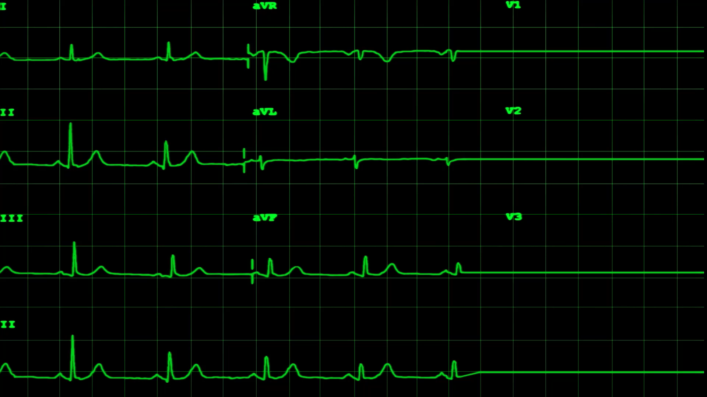
Real-world Applications
Clinical Implementation
Integration with existing patient monitoring systems
Continuous blood pressure tracking in ambulatory settings
Remote patient monitoring capabilities
Early detection of hypertensive episodes
Healthcare Benefits
Real-time data processing for immediate intervention
Enhanced patient comfort and compliance
Reduced measurement artifacts
24/7 monitoring potential
Department of Applied Data Science

Slide 25
Advantages over Traditional Methods
Comparison with Cuff-based Methods
Elimination of measurement intermittency
Reduction in white coat hypertension effects
Enhanced temporal resolution for continuous monitoring
Improved patient comfort during long-term use
Monitoring Capabilities
Real-time blood pressure tracking
Continuous cardiovascular assessment
Enhanced trend analysis capabilities
Early detection of cardiovascular events
Department of Applied Data Science

Slide 26
Limitations and Challenges
Current Technical Constraints
Cross-subject generalizability issues
Calibration requirements
Motion artifact sensitivity
Resource optimization needs
Implementation Challenges
Signal quality variations
Hardware constraints
Power consumption optimization
Real-time processing demands
Department of Applied Data Science

Slide 27
Future Directions
Edge Computing Optimization
Multi-device distributed inference capabilities
Hardware-specific optimization strategies
Dynamic workload balancing across devices
Model Enhancement
Advanced quantization techniques for improved accuracy
Model pruning and compression optimization
Knowledge distillation for smaller, efficient models
Hardware-aware neural architecture search
Clinical Implementation
Real-time collaborative inference systems
Enhanced privacy-preserving techniques
Adaptive model calibration methods
Cross-platform deployment strategies
Hardware Integration
Custom accelerator development
Power-efficient processing units
Optimized memory management systems
Specialized edge AI processors
System Improvements
Automated model optimization pipelines
Dynamic resource allocation frameworks
Enhanced fault tolerance mechanisms
Improved battery life optimization
Department of Applied Data Science

Slide 28
Conclusion
Key Findings
Achievement of clinical-grade accuracy (MAE: 6.36 mmHg for SBP)
Successful model compression (90.71% reduction)
Real-time inference capabilities (2.6ms)
Robust cross-validation performance
Department of Applied Data Science

Slide 29
Thank you.
Department of Applied Data Science

